Slide 1
ChainChamps
Team 20
Use Case 4: Application of Remote Sensing
In Environmental Monitoring

Slide 2
Problem Statement
The lack of visibility regarding CO2 emissions
from industrial plants

Slide 3
Problem Statement
The pain: the need for
Carbon footprint visibility for financial purposes
Attracting stakeholders demanding transparency and sustainable practises
Managing high risks associated to high carbon footprints.
Notes:
To better address the problem, we can think of the needs of potential customers such as

Slide 4
Solution overview
A platform that offers carbon footprint visibility by providing dashboards and graphs including AI models to predict future emissions.
Notes:
one of the key functionalities** is providing alerts based on industry regulations and the customer’s request

Slide 5
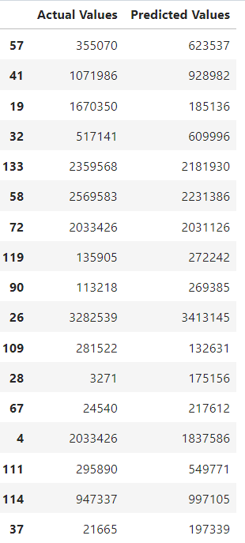
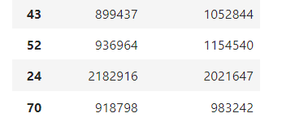
Demo
Notes:
explain the demo

Slide 6

Market Validation
Experts’ consultations+testing
export models+integration
Marketing strategy dev+ contact potential customers&stakeholders
at least 1 contract with a customer+ radio spot+ followed marketing strategy
1st week
2nd week
3rd week
4th week
5th week
6th week
7th week
8th week
Acquiring more data
+training models
+conceiving+developing the platform+ databases
at least 1 contract with a collaborator + finalize the platform
Notes:
elaborate** 3rd week: exporting models+integrating them in the platform

Slide 7
Thank you for your attention!

